Slide 1



Technology
Course Code : Eng 101
Course Title : Communicative English
Batch : 60-I
Presented by : Presented to :
Group-1
MD RIAD HASAN (2233081332) [LEADER]
MAHMUDUL HASSAN (2233081348)
LUTFUN NAHAR BARSHA (2233081334)
NILOY HASAN NAHID (2233081350)
MD KAMRUL ISLAM (2233081339)
Mst. Sultana Akter Shapla
Lecturer (English)
Computer Science & Engineering
Uttara University, Dhaka.

Slide 2

Introduction
Welcome, everyone!
Today, we live in the dynamic world of technology, an era where innovation knows no bounds.
As we navigate through this presentation, we'll explore the ever-evolving landscape of technology.

Slide 3

Goals of technology
Technology makes our life easier. But it should go on to long. In a short time of modern eta, it has changes our life in many points. Such as :
Global Connectivity
Information access and Sharing
Data Management and Analysis
Education and Skill Development
Security and Privacy
Health and Well being
Economic Growth and Job Creation
Entertainment and Recreation

Slide 4


Objectives & description
Internet of Things :
The Internet is a global network of interconnected computers, enabling the exchange of information, communication, and access to a vast array of online resources. It serves as a infrastructure that includes modern communication, commerce, and knowledge sharing.
It has many sectors of uses, such as –
Social Media : Social media is internet-based and gives users quick electronic communication of contents. It is also related with Information Technology that bring people closer together in various acts.

Slide 5

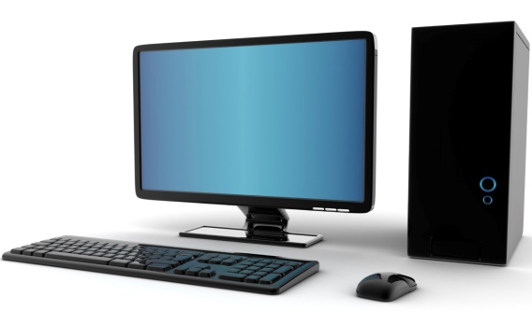
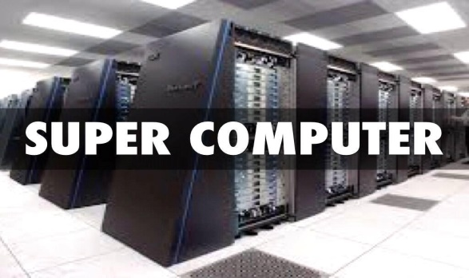
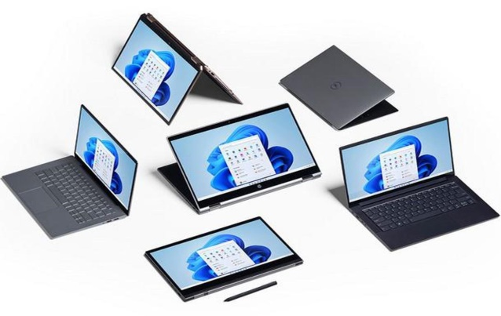
.
Computers :
A computer is an electronic device that manipulates information, or data. It has the ability to store, retrieve and process data.
Types of Computers –
Mainframe Computer
Super Computer
Desktop Computer
Personal Computer

Slide 6

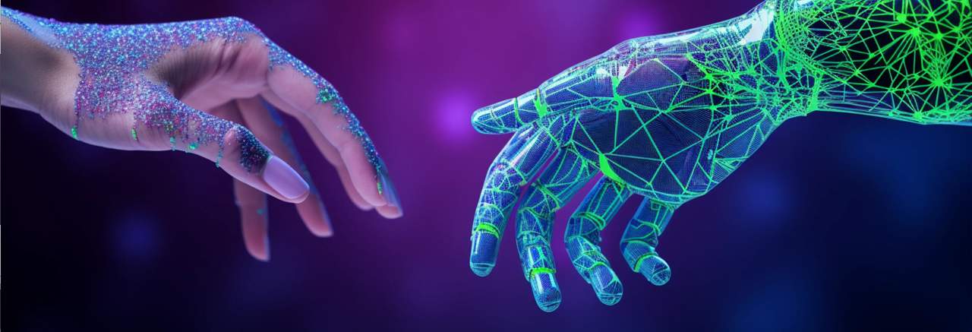
.
Artificial Intelligence (AI) :
Artificial Intelligence is the simulation of human intelligence processes by machines, especially ChatGPT system.
ChatGPT is a face-to-use AI System. Use it for engaging conversations, gain insights, automated tasks, and witness the future of AI.
Here’s what to know about each –
Artificial Narrow Intelligence
Reactive Machines
Theory of Mind

Slide 7


.
Cyber Security :
Cyber security is the practice of protecting computer systems, networks, and data from digital threats, attacks, and unauthorized access. As technology advances, cyber security plays a critical role in safeguarding individuals, organizations, and governments against evolving cyber risks.

Slide 8
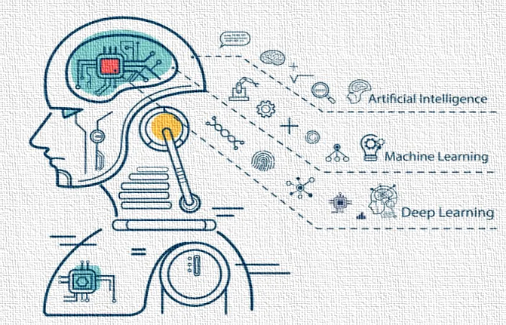
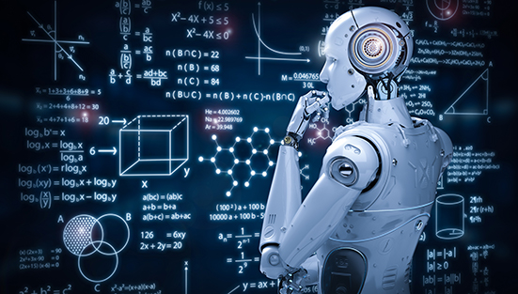
.
Robotics :
Robotics is a branch of engineering and computer science that involves the conception design, manufacture and operation of robots. The objective of the robotics field is to create intelligent machines that can assist in a variety of ways.
Examples of Robotics –
Robot
Industrial Robot
Articulated Robot
Self Driving Cars
Self Driving Fighter Jet

Slide 9
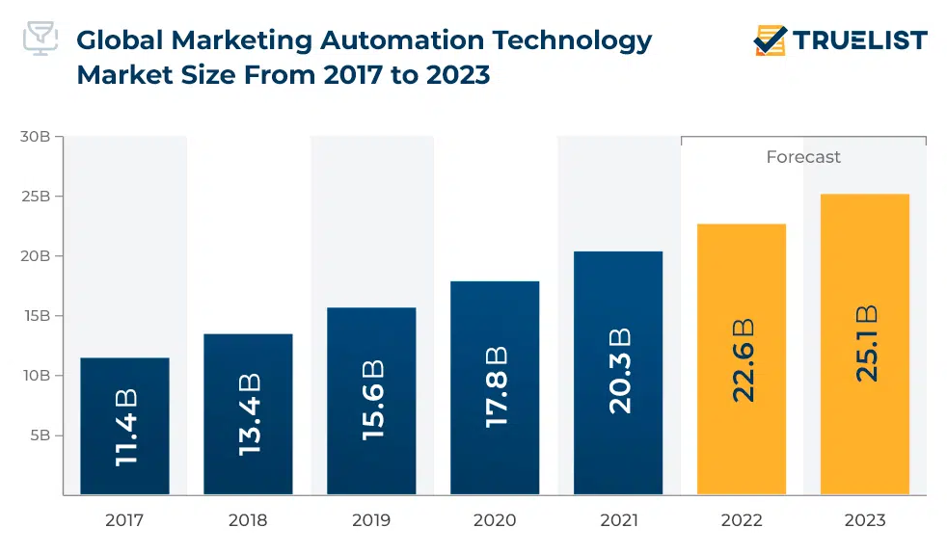
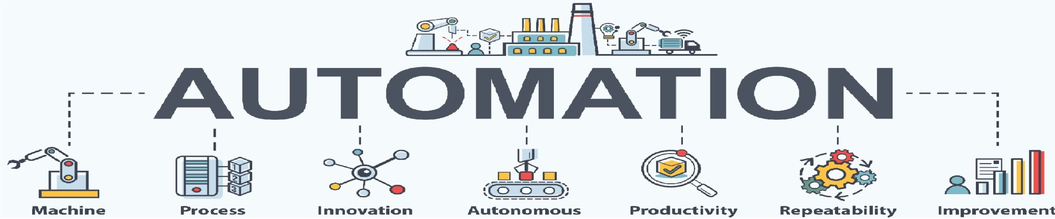
.
Automation :
Automation involves machines working independently, crucial for advanced technologies. Robotics, a part of automation, makes machines perform tasks independently.
Benefits of Automation –
Enhances productivity and efficiently.
Cost Savings
Reduces waste
Minimizes environmental bad effects.
Ensure security
Generates new jobs
Despite job cuts from automation, staying employable requires ongoing skill improvement for new opportunities.

Slide 10


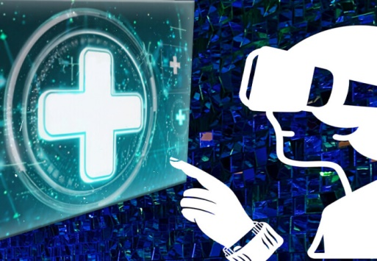
.
Educational Skill Development & Health :
Nowadays , It has a huge technological demands on Educational Development and Health (Medical). Online classes, Creating many presentations on various sdutycal topics are good examples of developing one’s curricular skills.
On the other hand, uses of X-Ray, Telehealth, Healthcare Technology, ETT Machines, Nanotechnology, Inhalers, Robotic Surgery are of most used technologies in modern era.

Slide 11
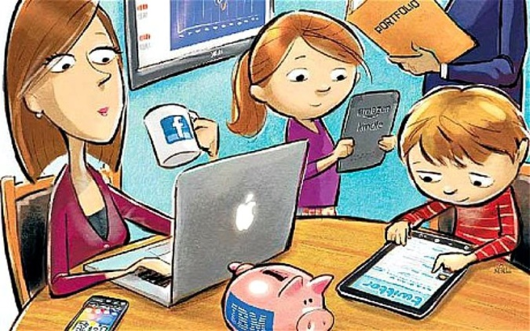


Effects of technology
The effects of technology on society are vast and multifaceted. Here are some key points highlighting on negative aspects :
Dependence and Addiction
Privacy Concerns
Cyber Security Threats
Job Displacement
Social Isolation
Environmental Impact
Health Issues
Digital Divide

Slide 12
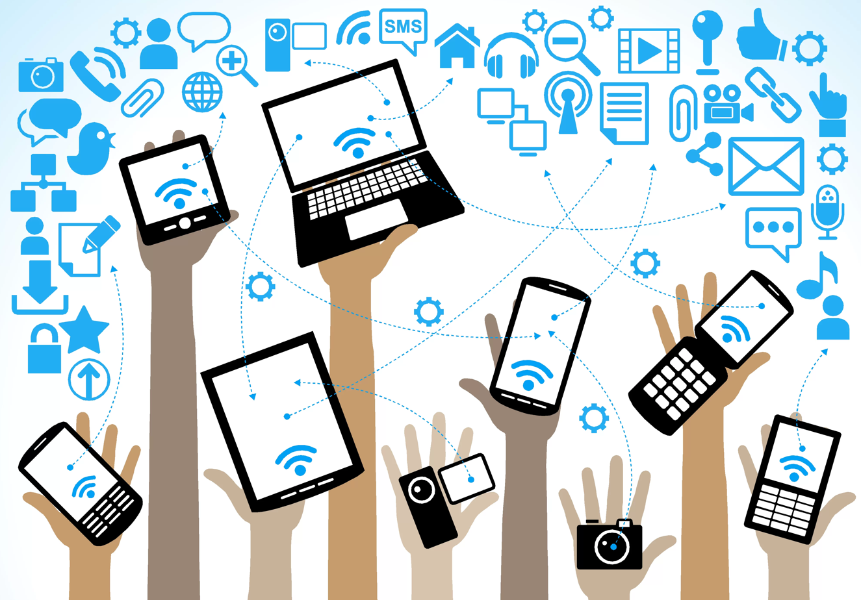
Conclusion
In conclusion, we can say that technology is much needed for our daily activities which we can’t ignore. So, we need to go on and on to make safe uses of technologies as well.

Slide 13


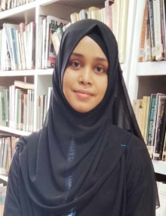
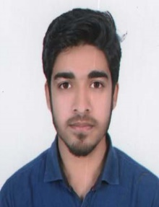


.
Any Question or Comment?

